Slide 1

CSE 473
Pattern Recognition

Slide 2
Context Dependent Classification

Slide 3
Context Dependent Classification
Recall context free classification
  No relation exist among classes
  No relation exists among objects (feature vectors)
  A new object is classified to any class independent of the previous objects’ classes

Slide 4
Context Dependent Classification
In Context dependent classification, the class of a feature vector depends on
  Its own value
  Value of other feature vectors
  Classes assigned to other vectors

Slide 5
Context Dependent Classification
Application
  Communication
  Image Processing
  Signal Processing

Slide 6
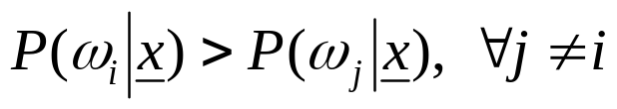
Solution for Context Dependent Classification
Recall Bayesian formulation for context free classification
  Assign x to ω_{i} if
In context dependent classification, we cannot apply it directly because of interdependency of features and classes

Slide 7
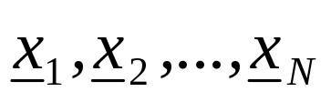
Solution for Context Dependent Classification
This interrelation demands the classification to be performed simultaneously for all available feature vectors
we assume that the training vectors
occur in sequence, one after the other and we will refer to them as observations

Slide 8
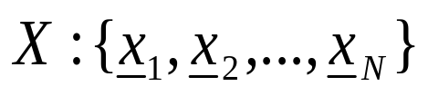



Context Dependent Bayesian Classifier
Let be sequence of observations
Let be the available M classes
Let be a possible sequence of assigned classes, that is
  where,
There are M^{N} of

Slide 9
Context Dependent Bayesian Classifier
Now, given and
Classify X to using the Bayesian rule
This is equivalent to classifying

Slide 10
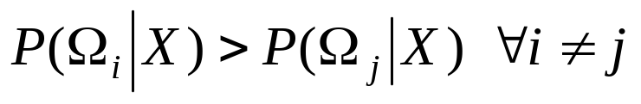

Context Dependent Bayesian Classifier
The rule
can be simplified as

Slide 11
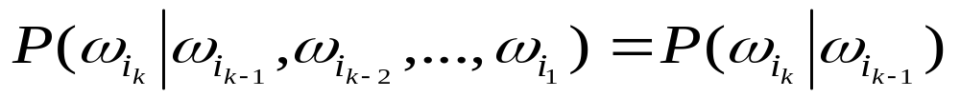
Further Simplification: Markov Chain Model
Markov Chain Models (for class dependence)
which means class dependence is limited to only within two successive classes

Slide 12
Further Simplification: Markov Chain Model
Markov Chain Models (for class dependence)
in other words,
if
then
depends on the class from which observation x_{k-1}, at stage k-1 has occurred

Slide 13

Further Simplification: Markov Chain Model
Markov Chain Models (for class dependence)
Therefore, we can write

Slide 14

Further Simplification: Markov Chain Model
Markov Chain Models (for class dependence)
Therefore, we can write
We find,

Slide 15

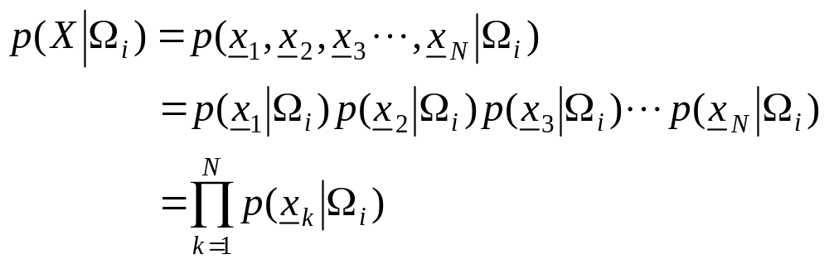
Further Simplification: Markov Chain Model
Further assumption
  statistically mutually independent

Slide 16
Further Simplification: Markov Chain Model
Further assumption
  statistically mutually independent
  If the pdf in one class is independent of the others, then

Slide 17
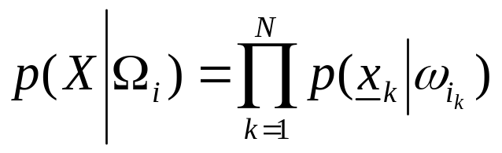
Further Simplification: Markov Chain Model
Further assumption
  statistically mutually independent
  The pdf in one class independent of the others, then
  Finally,

Slide 18
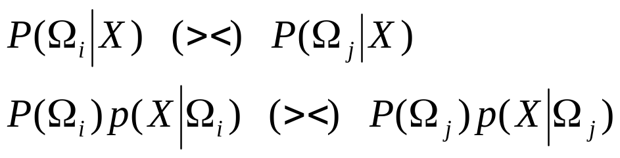
Further Simplification: Markov Chain Model
From the above, the Bayes rule is readily seen to be equivalent to:

Slide 19
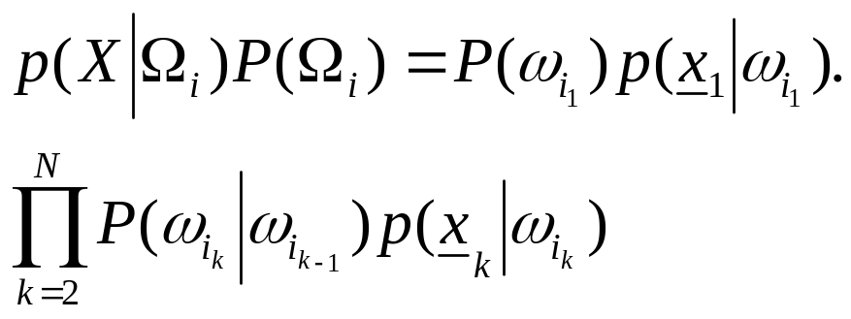
Further Simplification: Markov Chain Model
From the above, the Bayes rule is readily seen to be equivalent to:
that is, it turns to:

Slide 20
Further Simplification: Markov Chain Model
From the above, the Bayes rule is readily seen to be equivalent to:
that is, it rests on
To find the above maximum in brute-force task we need Ο(NM^{Ν} ) operations!!

Slide 21
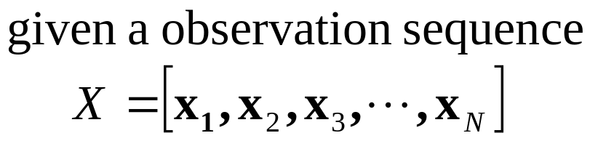
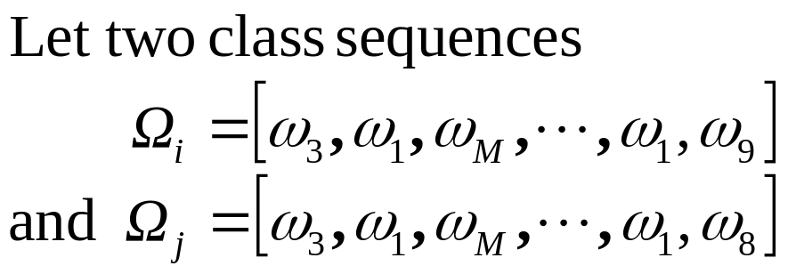
Further Simplification: Markov Chain Model

Slide 22
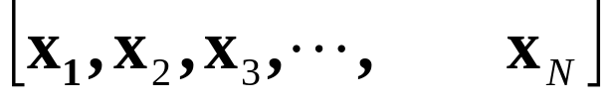
Further Simplification: Markov Chain Model

Slide 23
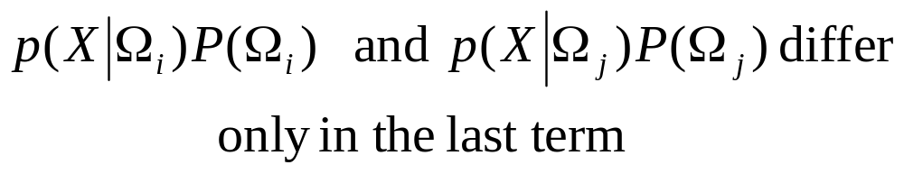
Further Simplification: Markov Chain Model

Slide 24
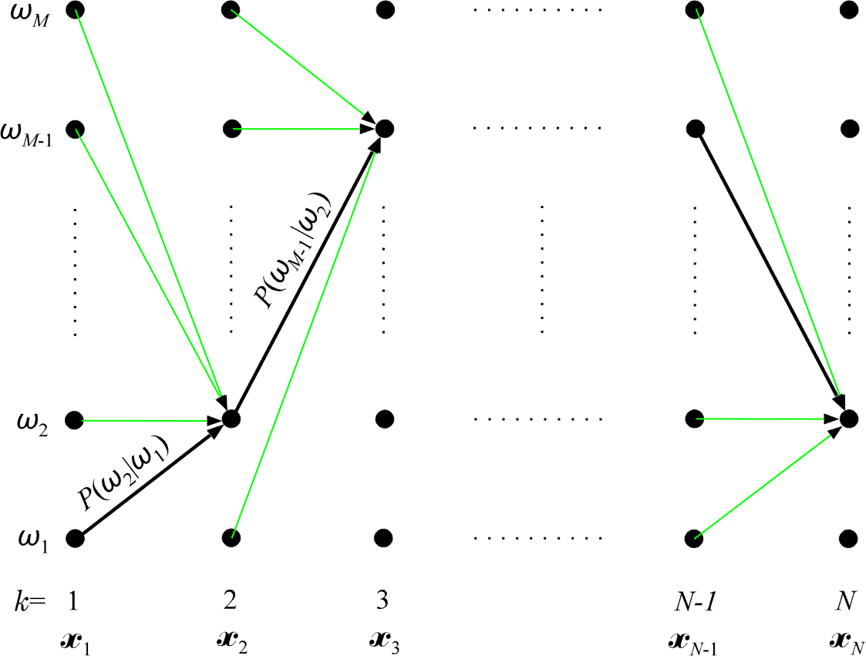
Viterbi Algorithm: Calculate p(X|Ω_{i})p(Ω_{i})

Slide 25
Viterbi Algorithm: Calculate p(X|Ω_{i})p(Ω_{i})
N dot columns
M possible classes
Successive columns correspond to successive observations x_{k}, k= 1, 2, …, N
Each of the class sequences Ω_{i} corresponds to a specific path of successive transitions

Slide 26
Viterbi Algorithm: Calculate p(X|Ω_{i})p(Ω_{i})
Each transition from class ω_{i} to ω_{j} has a fixed probability P(ω_{j} | ω_{i} )
Also, assume p(x| ω_{i} ) is known

Slide 27
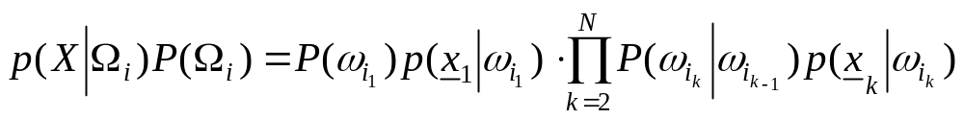
Viterbi Algorithm: Calculate p(X|Ω_{i})p(Ω_{i})
Now the problem can be stated as,
Given a sequence of observations x₁, x₂, . . . , x_{N}, find the path of successive (class) transitions that maximizes

Slide 28
Viterbi Algorithm: Calculate p(X|Ω_{i})p(Ω_{i})
Now the problem can be stated as,
Given a sequence of observations x₁, x₂, . . . , x_{N}, find the path of successive (class) transitions that maximizes
That is, find an optimal path (e. g., the black line)

Slide 29
Viterbi Algorithm: Calculate p(X|Ω_{i})p(Ω_{i})
The classes along this optimal path are the classes of the respective observations.

Slide 30
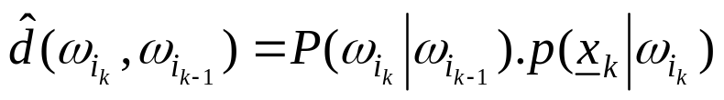
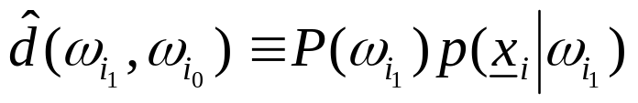
Viterbi Algorithm: Calculate p(X|Ω_{i})p(Ω_{i})
Looking at
The cost of a transition is
And the cost at initial transition
is

Slide 31
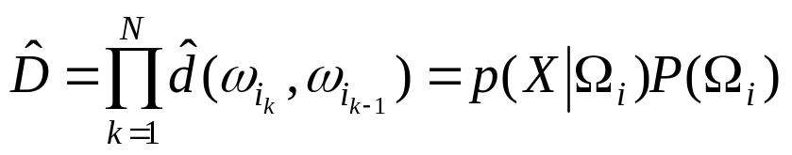
Viterbi Algorithm: Calculate p(X|Ω_{i})p(Ω_{i})
Using the notations
and
The equation
can be written as

Slide 32


Viterbi Algorithm: Calculate p(X|Ω_{i})p(Ω_{i})
The equation
can be written as

Slide 33
Viterbi Algorithm: Calculate p(X|Ω_{i})p(Ω_{i})
The equation
can be written as
We can use Bellman’s optimality principle!!!

Slide 34

Viterbi Algorithm: Calculate p(X|Ω_{i})p(Ω_{i})
To use Bellman’s theorem
  Define the cost up to node k as

Slide 35
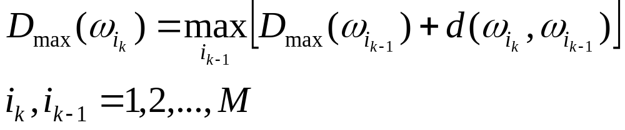

Viterbi Algorithm: Calculate p(X|Ω_{i})p(Ω_{i})
To use Bellman’s theorem
  Define the cost up to node k as
  Bellman’s principle now states
with

Slide 36

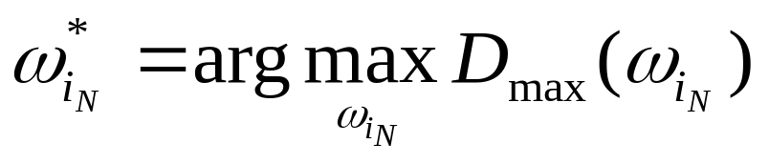
Viterbi Algorithm: Calculate p(X|Ω_{i})p(Ω_{i})
  Bellman’s principle now states
with
  Finally, the optimal path terminates at

Slide 37
Viterbi Algorithm: Calculate p(X|Ω_{i})p(Ω_{i})
    Total M nodes in each of N columns
    Each node has M transitions
    Thus, complexity is O (NM²)

Slide 38
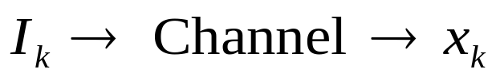
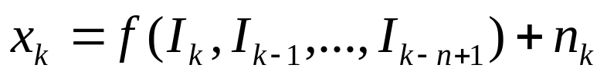
Application in Channel Equalization
The problem
  Information bits I_{k} are transmitted
  We receive x_{k}
    where, f is the action of channel
    n_{k} is the noise

Slide 39
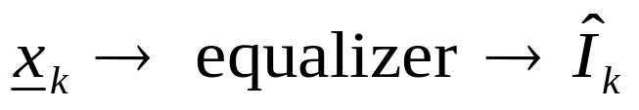
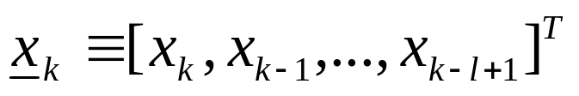
Application in Channel Equalization
We want the bits back
where,

Slide 40
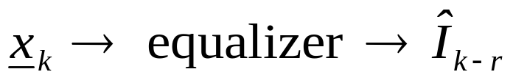
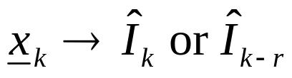
Application in Channel Equalization
We want the bits back
OR if we allow delay r

Slide 41

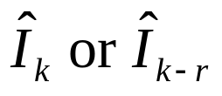
Application in Channel Equalization
We want the bits back
OR if we allow delay r
This means we use the vector to get a single bit

Slide 42
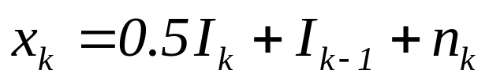
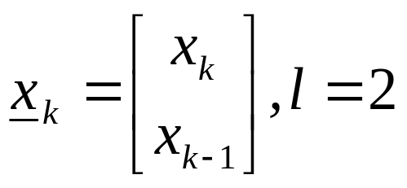
Application in Channel Equalization
Example
    In vector x_{k} three input symbols are involved:
    I_{k}, I_{k-1}, I_{k-2}

Slide 43

Application in Channel Equalization
Assuming n_{k} =0
I_{k} | I_{k-1} | I_{k-2}
0 | 0 | 0
0 | 0 | 1
0 | 1 | 0
0 | 1 | 1
1 | 0 | 0
1 | 0 | 1
1 | 1 | 0
1 | 1 | 1

Slide 44
Application in Channel Equalization
Assuming n_{k} =0
 |  | I_{k-2}
 |  | 0
 |  | 1
 |  | 0
 |  | 1
 |  | 0
 |  | 1
 |  | 0
 |  | 1

Slide 45
Application in Channel Equalization
Assuming n_{k} =0
 | I_{k-1} | I_{k-2}
 | 0 | 0
 | 0 | 1
 | 1 | 0
 | 1 | 1
 | 0 | 0
 | 0 | 1
 | 1 | 0
 | 1 | 1

Slide 46
Application in Channel Equalization
Assuming n_{k} =0
I_{k} | I_{k-1} | I_{k-2}
0 | 0 | 0
0 | 0 | 1
0 | 1 | 0
0 | 1 | 1
1 | 0 | 0
1 | 0 | 1
1 | 1 | 0
1 | 1 | 1

Slide 47


Application in Channel Equalization
Assuming n_{k} =0
 | I_{k-1} | I_{k-2} |  | x_{k-1}
0 | 0 | 0 | 0 | 0 | ω₁
0 | 0 | 1 | 0 | 1 | ω₂
0 | 1 | 0 | 1 | 0.5 | ω₃
0 | 1 | 1 | 1 | 1.5 | ω₄
1 | 0 | 0 | 0.5 | 0 | ω₅
1 | 0 | 1 | 0.5 | 1 | ω₆
1 | 1 | 0 | 1.5 | 0.5 | ω₇
1 | 1 | 1 | 1.5 | 1.5 | ω₈

Slide 48


Application in Channel Equalization
Assuming n_{k} =0
I_{k} | I_{k-1} | I_{k-2} | x_{k} | x_{k-1}
0 | 0 | 0 | 0 | 0 | ω₁
0 | 0 | 1 | 0 | 1 | ω₂
0 | 1 | 0 | 1 | 0.5 | ω₃
0 | 1 | 1 | 1 | 1.5 | ω₄
1 | 0 | 0 | 0.5 | 0 | ω₅
1 | 0 | 1 | 0.5 | 1 | ω₆
1 | 1 | 0 | 1.5 | 0.5 | ω₇
1 | 1 | 1 | 1.5 | 1.5 | ω₈

Slide 49
Application in Channel Equalization
Assuming n_{k} =0
Estimate I_{k} from (x_{k}, x_{k-1})
I_{k} | I_{k-1} | I_{k-2} | x_{k} | x_{k-1}
0 | 0 | 0 | 0 | 0 | ω₁
0 | 0 | 1 | 0 | 1 | ω₂
0 | 1 | 0 | 1 | 0.5 | ω₃
0 | 1 | 1 | 1 | 1.5 | ω₄
1 | 0 | 0 | 0.5 | 0 | ω₅
1 | 0 | 1 | 0.5 | 1 | ω₆
1 | 1 | 0 | 1.5 | 0.5 | ω₇
1 | 1 | 1 | 1.5 | 1.5 | ω₈

Slide 50
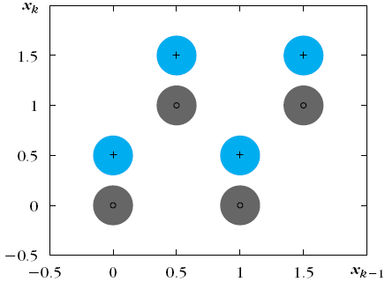
Application in Channel Equalization
Assuming n_{k} =0
I_{k} | I_{k-1} | I_{k-2} | x_{k} | x_{k-1}
0 | 0 | 0 | 0 | 0 | ω₁
0 | 0 | 1 | 0 | 1 | ω₂
0 | 1 | 0 | 1 | 0.5 | ω₃
0 | 1 | 1 | 1 | 1.5 | ω₄
1 | 0 | 0 | 0.5 | 0 | ω₅
1 | 0 | 1 | 0.5 | 1 | ω₆
1 | 1 | 0 | 1.5 | 0.5 | ω₇
1 | 1 | 1 | 1.5 | 1.5 | ω₈
+
+
_{º}
_{º}
+
+
_{º}
_{º}
Eight possible clusters

Slide 51
Application in Channel Equalization
Assuming n_{k} =0
I_{k} | I_{k-1} | I_{k-2} | x_{k} | x_{k-1}
0 | 0 | 0 | 0 | 0 | ω₁
0 | 0 | 1 | 0 | 1 | ω₂
0 | 1 | 0 | 1 | 0.5 | ω₃
0 | 1 | 1 | 1 | 1.5 | ω₄
1 | 0 | 0 | 0.5 | 0 | ω₅
1 | 0 | 1 | 0.5 | 1 | ω₆
1 | 1 | 0 | 1.5 | 0.5 | ω₇
1 | 1 | 1 | 1.5 | 1.5 | ω₈
+
+
_{º}
_{º}
+
+
_{º}
_{º}
‘+’ means I_{k} was 1, ‘o’ means I_{k} was 0

Slide 52
Application in Channel Equalization
I_{k} | I_{k-1} | I_{k-2} | x_{k} | x_{k-1}
0 | 0 | 0 | 0 | 0 | ω₁
0 | 0 | 1 | 0 | 1 | ω₂
0 | 1 | 0 | 1 | 0.5 | ω₃
0 | 1 | 1 | 1 | 1.5 | ω₄
1 | 0 | 0 | 0.5 | 0 | ω₅
1 | 0 | 1 | 0.5 | 1 | ω₆
1 | 1 | 0 | 1.5 | 0.5 | ω₇
1 | 1 | 1 | 1.5 | 1.5 | ω₈
Big cluster exists when the noise n_{k} is NOT 0 (zero)

Slide 53
Application in Channel Equalization
I_{k} | I_{k-1} | I_{k-2} | x_{k} | x_{k-1}
0 | 0 | 0 | 0 | 0 | ω₁
0 | 0 | 1 | 0 | 1 | ω₂
0 | 1 | 0 | 1 | 0.5 | ω₃
0 | 1 | 1 | 1 | 1.5 | ω₄
1 | 0 | 0 | 0.5 | 0 | ω₅
1 | 0 | 1 | 0.5 | 1 | ω₆
1 | 1 | 0 | 1.5 | 0.5 | ω₇
1 | 1 | 1 | 1.5 | 1.5 | ω₈
Estimate from (x_{k}, x_{k-1})
A two class problem
Each class is a union of clusters

Slide 54
Solution (1)
I_{k} | I_{k-1} | I_{k-2} | x_{k} | x_{k-1}
0 | 0 | 0 | 0 | 0 | ω₁
0 | 0 | 1 | 0 | 1 | ω₂
0 | 1 | 0 | 1 | 0.5 | ω₃
0 | 1 | 1 | 1 | 1.5 | ω₄
1 | 0 | 0 | 0.5 | 0 | ω₅
1 | 0 | 1 | 0.5 | 1 | ω₆
1 | 1 | 0 | 1.5 | 0.5 | ω₇
1 | 1 | 1 | 1.5 | 1.5 | ω₈
During training,
  send all values of (I_{k-2}, I_{k-1}, I_{k}) and calculate (x_{k-1}, x_{k})
  Calculate the cluster centers μ_{k}
  Assign the bit I_{k} to the cluster μ_{k}

Slide 55
Solution (1)
I_{k} | I_{k-1} | I_{k-2} | x_{k} | x_{k-1}
? |  |  | 0 | 0 | ω₁
? |  |  | 0 | 1 | ω₂
? |  |  | 1 | 0.5 | ω₃
? |  |  | 1 | 1.5 | ω₄
? |  |  | 0.5 | 0 | ω₅
? |  |  | 0.5 | 1 | ω₆
? |  |  | 1.5 | 0.5 | ω₇
? |  |  | 1.5 | 1.5 | ω₈
During equalization (testing),
  Get (x_{k-1}, x_{k}) from the channel
  Find the nearest cluster μ_{i}
  The bit of μ_{i} is the estimated transmitted bit

Slide 56

Solution (2)
I_{k} | I_{k-1} | I_{k-2} | x_{k} | x_{k-1}
0 | 0 | 0 | 0 | 0 | ω₁
0 | 0 | 1 | 0 | 1 | ω₂
0 | 1 | 0 | 1 | 0.5 | ω₃
0 | 1 | 1 | 1 | 1.5 | ω₄
1 | 0 | 0 | 0.5 | 0 | ω₅
1 | 0 | 1 | 0.5 | 1 | ω₆
1 | 1 | 0 | 1.5 | 0.5 | ω₇
1 | 1 | 1 | 1.5 | 1.5 | ω₈
Let
  which corresponds to ω₂

Slide 57
Solution (2)
I_{k} | I_{k-1} | I_{k-2} | x_{k} | x_{k-1}
0 | 0 | 0 | 0 | 0 | ω₁
0 | 0 | 1 | 0 | 1 | ω₂
0 | 1 | 0 | 1 | 0.5 | ω₃
0 | 1 | 1 | 1 | 1.5 | ω₄
1 | 0 | 0 | 0.5 | 0 | ω₅
1 | 0 | 1 | 0.5 | 1 | ω₆
1 | 1 | 0 | 1.5 | 0.5 | ω₇
1 | 1 | 1 | 1.5 | 1.5 | ω₈
Let
  which corresponds to ω₂

Slide 58
Solution (2)
I_{k+1} | I_{k} | I_{k-1} | I_{k-2} | x_{k} | x_{k-1}
? | 0 | 0 | 0 | 0 | 0 | ω₁
? | 0 | 0 | 1 | 0 | 1 | ω₂
? | 0 | 1 | 0 | 1 | 0.5 | ω₃
? | 0 | 1 | 1 | 1 | 1.5 | ω₄
? | 1 | 0 | 0 | 0.5 | 0 | ω₅
? | 1 | 0 | 1 | 0.5 | 1 | ω₆
? | 1 | 1 | 0 | 1.5 | 0.5 | ω₇
? | 1 | 1 | 1 | 1.5 | 1.5 | ω₈
Let
  which corresponds to ω₂
What will be the next bit I_{k+1}

Slide 59

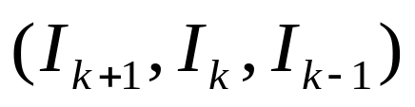
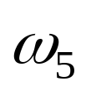


Solution (2)
I_{k+1} | I_{k} | I_{k-1} | I_{k-2} | x_{k} | x_{k-1}
? | 0 | 0 | 0 | 0 | 0 | ω₁
0, 1 | 0 | 0 | 1 | 0 | 1 | ω₂
? | 0 | 1 | 0 | 1 | 0.5 | ω₃
? | 0 | 1 | 1 | 1 | 1.5 | ω₄
? | 1 | 0 | 0 | 0.5 | 0 | ω₅
? | 1 | 0 | 1 | 0.5 | 1 | ω₆
? | 1 | 1 | 0 | 1.5 | 0.5 | ω₇
? | 1 | 1 | 1 | 1.5 | 1.5 | ω₈
Let
  which corresponds to ω₂
The next bit I_{k+1} can be either 1 or 0

Slide 60
Solution (2)
I_{k+1} | I_{k} | I_{k-1} | I_{k-2} | x_{k} | x_{k-1}
? | 0 | 0 | 0 | 0 | 0 | ω₁
0, 1 | 0 | 0 | 1 | 0 | 1 | ω₂
? | 0 | 1 | 0 | 1 | 0.5 | ω₃
? | 0 | 1 | 1 | 1 | 1.5 | ω₄
? | 1 | 0 | 0 | 0.5 | 0 | ω₅
? | 1 | 0 | 1 | 0.5 | 1 | ω₆
? | 1 | 1 | 0 | 1.5 | 0.5 | ω₇
? | 1 | 1 | 1 | 1.5 | 1.5 | ω₈
This means, all transitions are not possible!!
In other words, after (0, 0, 1) we will find
either (1, 0, 0)
or (0, 0, 0)

Slide 61
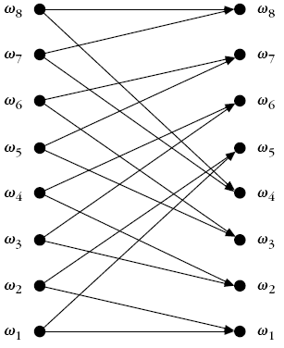
Solution (2)
I_{k+1} | I_{k} | I_{k-1} | I_{k-2} | x_{k} | x_{k-1}
0, 1 | 0 | 0 | 0 | 0 | 0 | ω₁
0, 1 | 0 | 0 | 1 | 0 | 1 | ω₂
0, 1 | 0 | 1 | 0 | 1 | 0.5 | ω₃
0, 1 | 0 | 1 | 1 | 1 | 1.5 | ω₄
0, 1 | 1 | 0 | 0 | 0.5 | 0 | ω₅
0, 1 | 1 | 0 | 1 | 0.5 | 1 | ω₆
0, 1 | 1 | 1 | 0 | 1.5 | 0.5 | ω₇
0, 1 | 1 | 1 | 1 | 1.5 | 1.5 | ω₈
This means, all transitions are NOT possible!!
Alternately, after (0, 0, 1) we can get either (1, 0, 0) or (0, 0,0)

Slide 62
Solution (2)
I_{k+1} | I_{k} | I_{k-1} | I_{k-2} | x_{k} | x_{k-1}
0, 1 | 0 | 0 | 0 | 0 | 0 | ω₁
0, 1 | 0 | 0 | 1 | 0 | 1 | ω₂
0, 1 | 0 | 1 | 0 | 1 | 0.5 | ω₃
0, 1 | 0 | 1 | 1 | 1 | 1.5 | ω₄
0, 1 | 1 | 0 | 0 | 0.5 | 0 | ω₅
0, 1 | 1 | 0 | 1 | 0.5 | 1 | ω₆
0, 1 | 1 | 1 | 0 | 1.5 | 0.5 | ω₇
0, 1 | 1 | 1 | 1 | 1.5 | 1.5 | ω₈
We can use Viterbi algorithm now !!!

Slide 63
Solution (2): Viterbi Algorithm
I_{k+1} | I_{k} | I_{k-1} | I_{k-2} | x_{k} | x_{k-1}
0, 1 | 0 | 0 | 0 | 0 | 0 | ω₁
0, 1 | 0 | 0 | 1 | 0 | 1 | ω₂
0, 1 | 0 | 1 | 0 | 1 | 0.5 | ω₃
0, 1 | 0 | 1 | 1 | 1 | 1.5 | ω₄
0, 1 | 1 | 0 | 0 | 0.5 | 0 | ω₅
0, 1 | 1 | 0 | 1 | 0.5 | 1 | ω₆
0, 1 | 1 | 1 | 0 | 1.5 | 0.5 | ω₇
0, 1 | 1 | 1 | 1 | 1.5 | 1.5 | ω₈
We need to define:
P(ω_{i}| ω_{j})
Cost function

Slide 64
Solution (2): Viterbi Algorithm
I_{k+1} | I_{k} | I_{k-1} | I_{k-2} | x_{k} | x_{k-1}
0, 1 | 0 | 0 | 0 | 0 | 0 | ω₁
0, 1 | 0 | 0 | 1 | 0 | 1 | ω₂
0, 1 | 0 | 1 | 0 | 1 | 0.5 | ω₃
0, 1 | 0 | 1 | 1 | 1 | 1.5 | ω₄
0, 1 | 1 | 0 | 0 | 0.5 | 0 | ω₅
0, 1 | 1 | 0 | 1 | 0.5 | 1 | ω₆
0, 1 | 1 | 1 | 0 | 1.5 | 0.5 | ω₇
0, 1 | 1 | 1 | 1 | 1.5 | 1.5 | ω₈
Assuming equiprobability of the next bit:
  P(ω₁| ω₁) = 0.5 = P(ω₁| ω₅)

Slide 65



Solution (2): Viterbi Algorithm
Cost function of transition
Where, either Euclidean distance
Or Mahalanobis distance
Can be used

